Slide 1
Introduction to ai
Unit 1

Slide 2
Outline
Overview
Definition of AI
AI and Related Fields
Brief History of AI
Applications of AI
Importance of AI
Definition of Knowledge and Learning
Importance of Knowledge and Learning
Intelligent Agents and it types and performance measures

Slide 3
Overview- Background
Humans and Mental Capacities
How we Think?
How we Perceive, Understand, Predict and Manipulate a large and complicated world?
Understand Intelligent Entities
Build Intelligent Entities

Slide 4
Overview- AI and Its Subfields
General Purpose Areas
Learning
Perception
Natural Language Processing
Common-sense Reasoning
Robot Control
Specific Tasks
Games (Chess, Backgammon, Cards, Checkers, Tic-Tac-Toe)
Mathematical Theorems (Geometry, Calculus, Logic, Proving properties)
Scientific Analysis
Medical Analysis
Financial Analysis
Writing Literatures (Poems)
AI systemizes and automates intellectual tasks.

Slide 5
Definition of AI- What is AI?
A thought process
Reasoning
Fidelity to Human Performance
Rationality (doing right thing)

Slide 6
Definition of AI- Approaches to AI
Act Humanly: Turing Test Approach
Think Humanly: Cognitive Modelling Approach
Think Rationally: The Laws of Though Approach
Act Rationally: The Rational Agent Approach

Slide 7
Act Humanly: Turing Test Approach
The art of creating machines that perform functions that require intelligence when performed by people.(Kurzwail, 1990)
The study of how to make computers do things at which, at the moment, people are better.(Rich and Knight, 1991)
Based on Turing Test (Alan Turing, 1950)
Test based on indistinguishability from undeniably intelligent entities (human).
The computer passes a test if a human interrogator, after posing some written questions, can’t tell whether the responses were made by a human or not.

Slide 8
Act Humanly: Turing Test Approach
Capabilities need of the computer for the tests:
Natural Language Processing (ability to communicate successfully)
Knowledge Representation (store what it knows or hears)
Automated Reasoning (use the stored information to answer questions and draw new conclusions)
Machine Learning (adapt to new circumstances and to detect and extrapolate patterns)
And
Computer Vision (to perceive objects)
Robotics (to manipulate objects and move about)

Slide 9
Think Humanly: Cognitive Modelling Approach
The exciting new effort to make computers think… machines with minds, in the full and literal sense. (Haugeland, 1985)
“The automation of activities that we associate with human thinking, activities such as decision-making, problem solving, learning…”(Bellman, 1978)
Based on Cognitive Science
Cognitive science brings together compute models from AI and experimental techniques from psychology to try to construct precise and testable theories of the workings of the human mind.
Needs understanding of how human thinks?
Example: General Problem Solver-GPS

Slide 10
Think Rationally: The Laws of Thought Approach
The study of mental faculties through the use of computational models. (Charniak and McDermott, 1985)
The study of the computations that make it possible to perceive, reason and act. (Winston, 1992)
Based on Rational Thinking (Right Thinking)
Irrefutable Reasoning Process
Syllogisms providing patterns for argument structures that always yielded correct conclusions
Logic: the Laws of thought
Logicist tradition within AI hopes to build on such programs to create intelligent systems

Slide 11
Act Rationally: The Rational Agent Approach
Computational Intelligence is the study of the design of intelligent agents. (Poole et al., 1998)
AI… is concerned with intelligent behaviour in artifacts. (Nilsson, 1998)
Based on Intelligent Agents
Agents are the things that act. Computer agents are expected to have other attributes that distinguish them from mere “programs”, such as operating under autonomous control, perceiving their environment, persisting over a prolonged time period, adapting to change, and being capable of taking on another’s goals.
Rational agents are those who act so as to achieve the best outcome or, the best expected outcome when there is uncertainty.

Slide 12
AI and Related Fields- The Foundations of AI
Philosophy (428 B.C. – Present)
Drawing conclusions from the rules
Mental mind and physical brain
Where does knowledge come from?
How does knowledge lead to action?
Dualism, Materialism, Empiricism, Induction, Logical Positivism, Confirmation Theory
Mathematics (800 A.D. – Present)
What are the formal rules to draw conclusions?
What can be computed or manipulated?
How do we reason with uncertain information?
Algorithms, NP Completeness, Probability, Incompleteness Theorem, Intractability

Slide 13
AI and Related Fields- The Foundations of AI
Economics (1776 A.D. – Present)
How decisions can be made to maximize payoff?
How can something be done when others may not go along?
How can this be done when payoff may be far in future?
Decision Theory, Game Theory, Operations Research, Satisficing
Neuroscience (1861 A.D. – Present)
How are information processed by the human brain?
Neurons
Psychology (1879 A.D. – Present)
How do humans and animals think and act?
Behaviourism, Cognitive Psychology, Cognitive Science

Slide 14
AI and Related Fields- The Foundations of AI
Computer Engineering (1940 A.D. – Present)
How can we build an efficient computer?
Control theory and Cybernetics (1948 A. D. – Present)
How can artifacts operated under their own control?
Control Theory, Cybernetics, Objective Function
Linguistics (1957 A.D. – Present)
How does language relate to thought?
Computational Linguistics, NLP, Knowledge Representation

Slide 15
Brief History of AI- The Gestation Period (1943-1955)
Warren McCulloch and Walter Pitts (1943): 3 Sources (Knowledge of basic physiology and functions of neurons in brain; a formal analysis of propositional logic due to Russell and Whitehead; Turing’s theory of computation → proposed model of artificial neurons characterized by on/off logic that could even learn
Hebbian Learning (1949) by Donald Hebb: demonstration of simple updating rule for modification of the connections strengths between the neurons
Marvin Minsky and Dean Edmonds (1951): first neural network computer → SNARC (3000 Vacuum Tubes and a pilot mechanism from B-24 bomber to simulate a network of 40 neurons <Von Neumann>
Alan Turing (1950): “Computing Machinery and Intelligence” (Articulated a complete vision of AI, introducing Turing Test, Machine Learning, Genetic Algorithms, Reinforcement Learning)

Slide 16
Brief History of AI- The Birth (1956)
John McCarthy, Marvin Minsky, Claude Shannon and Nathaniel Rochester focused researches on automata theory, neural nets, and intelligence organizing a 2-month workshop (1956)
Two participants Allen Newell and Herbert Simon presented works on reasoning program named the Logic Theorist that was claimed to think non numerically and prove many theorems but the paper was not recognized by the Journal of Symbolic Logic
But the workshop laid the foundation for AI and the participants of the workshop became the leaders in the field of Artificial Intelligence

Slide 17
Brief History of AI: The Early Period (1952-1969)
General Problem Solver – Thinking Humanly Purpose
Nathaniel Rochester in IBM came with some of the first AI Programs
Herbert Gelernter (1959) – Geometry Theorem Prover
Arthur Samuel (1952) – Series of Programs for checkers leading to skilled checker program that could play better than its creator
John McCarthy (1958) – Contributions
Lisp- a high level dominant AI programming language
Paper entitled Programs and Common Sense described the Advice Taker as a complete AI System- use knowledge to search for solutions to problems
AI Lab at Stanford

Slide 18
Brief History of AI: The Early Period (1952-1969)
Marvin Minsky (1958) – anti logical outlook
J. A. Robinson – discovery of Resolution Method
Cordell Green (1969) – Question answering and planning system
Minsky’s Students focused on study to solve limited problems that seems to require AI and this domain is called microworlds.
James Slagle (1963) – SAINT program solved closed form calculus integration problems
Tom Evan (1968) – ANALOGY program solved geometric analogy problems

Slide 19
Brief History of AI: The Early Period (1952-1969)
Daniel Bobrow (1967) – STUDENT program solved algebra problems
David Huffman (1971) – The vision project
David Waltz (1975) – The vision and constraint propagation
Patrik Winston (1970) – The learning theory
Terry Winoguard (1972) – The natural language understanding program
Scott Fahlman (1974) – The planner
Block World – Rearrange the blocks using robot hand
McCulloch and Pitts – Neural Network
Bernie Widrow (1962) – Adalines
Frank Rosenblatt (1962) – Perceptron and Perceptron Convergence theorem

Slide 20
Brief History of AI: Reality Dawns (1966-1973)
Problems were faced while realization of AI Projects:
The most early programs contained little or no knowledge in their subject matter; success was merely based on simple syntactic manipulation
Intractability of many of the problems; microworlds were comparatively less complicated than real world problems
Fundamental limitations on the basic structures being used to generate intelligent behaviour → Limitations of existing neural network methods identified
AI failed to convince the funding agencies as the expectations were not matched

Slide 21
Brief History of AI: Knowledge Based Systems (1969-1979)
Problem Solving in prior period was based on weak methods → those try to string together the elementary reasoning steps to find complete solutions from a general purpose context
Alternative was suggested → domain specific knowledge that allows larger reasoning steps and can be easily used to handle typically occurring cases of narrow area of expertise
Development of knowledge based Systems
Buchanan et al. (1969) – The DENDRAL Program that solve the problem of inferring molecular structure from the information provided by mass spectrometer

Slide 22
Brief History of AI: Knowledge Based Systems (1969-1979)
Heuristic Programming Project to identify where could Expert Systems be used
MYCIN Program → used 450 rules to diagnose blood infections
Performed better than junior doctors
Roger Schank and his students developed a series of programs related to AI and Linguistics
Development of Successful Rule based Expert Systems
Minsky (1975) developed idea of frames → that adopted structured approach to assemble facts about particular object and event types and arrange them into a large taxonomy hierarchy analogous to a biological taxonomy

Slide 23
Brief History of AI: AI as an Industry (1980-Present)
R1 (1986) → first successful commercial expert system by DEC
Helps to configure orders for new computers
Saved $40 million for DEC
DEC (1988), developed 40 Expert Systems
Du Pont, 100 in use and 500 in pipeline
1981, Japan announced “Fifth Generation” Computers which were intelligent and US based company MCC also announced similar computer → Could not came to reality
AI Winter in the future due to unrealistic promises that were not delivered

Slide 24
Brief History of AI: Return of Neural Networks (1986-Present)
Neural networks return to popularity
Major advances in machine learning algorithms and applications
Reinvention of back-propagation learning algorithm in mid 1980s
Concept of Parallel Distributed Processing
Connectionist models of intelligent systems were seen which focused on unjustifiability of symbolic manipulation in decision making

Slide 25
Brief History of AI: AI as a Science (1987-Present)
AI focuses on scientific study
Integration of learning, reasoning, knowledge representation in AI
AI methods used in vision, language, data mining, etc.
Bayesian networks as a knowledge representation framework
Hidden Markov Models based on mathematical theory and training theories
Emergence of Intelligent Agents

Slide 26
Brief History of AI: Success Stories
Deep Blue defeated the reigning world chess champion Garry Kasparov in 1997
AI program proved a mathematical conjecture (Robbins conjecture) unsolved for decades
During the 1991 Gulf War, US forces deployed an AI logistics planning and scheduling program that involved up to 50,000 vehicles, cargo, and people
NASA's on-board autonomous planning program controlled the scheduling of operations for a spacecraft
Proverb solves crossword puzzles better than most humans
Robot driving: DARPA grand challenge 2003-2007
2006: face recognition software available in consumer cameras

Slide 27
Applications of AI
Autonomous Planning and Scheduling
Game Playing
Autonomous Control
Diagnosis
Logistics Planning
Robotics
Language understanding and Problem Solving

Slide 28
Importance of AI
Create a never-ending thought process and collective that could solve our problems
Thinking of every possible solution
With artificial intelligence, we could build computers, upon thousands of computers, that could all work in unison to solve our great and most dire problems

Slide 29
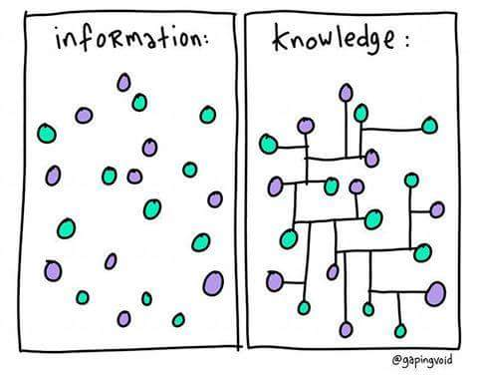
Definition of Knowledge and Learning
Knowledge is the justified true belief
Data → Information → Knowledge
Learning is the process of acquiring new or modifying and reinforcing the existing knowledge, behaviours, skills, or values through the synthesis and manipulation of information
Machine Learning → embedding the learning ability into the machine or computers

Slide 30
Importance of Knowledge and Learning
For Understanding the Environment
For Updating the Knowledge base
For Problem Solving
For Decision Making
For Building Intelligent Systems

Slide 31
Black-Box Model of Agent
An agent is anything that can be viewed as perceiving its environment through sensors and acting upon that environment through actuators.
Agent | Human | Machine
Sensors | Eyes, ears, other organs | Cameras, IR finder
Actuators | Hands, legs mouth, other body parts | Various motors for actuators
Percept
Environment
Agent [Sensors]
[Actuators]
Actions
Agent = architecture + programme

Slide 32
Agent
Rational Agent
Striving to do the right thing based on what it perceive and the action it can perform
Performance Measure: An objective Criterion for success of an agent’s behaviour.
Ex: Vacuum Cleaner : - amount of dirt cleaned, amount of time consumed, amount of electricity consumed, amount of noise generated, etc.
Intelligent Agent : Self Driving Car:
PEAS(Performance, Environment, Actuator, Sensors)
P: Safe, Fast, Legal, comfortable trip, maximize profit
E: Road, Other Traffics, Pedestrians, Customers
A: Steering Wheels, accelerator, brake, signal, horn
S: Cameras, Sonar, Speedometer, GPS, Odometer, Engine sensors, keyboard

Slide 33
Agent
Types of Environment
Fully observable (vs. partially observable): An agent's sensors give it access to the complete state of the environment at each point in time.
Deterministic (vs. stochastic): The next state of the environment is completely determined by the current state and the action executed by the agent. (If the environment is deterministic except for the actions of other agents, then the environment is strategic)
Episodic (vs. sequential): The agent's experience is divided into atomic "episodes" (each episode consists of the agent perceiving and then performing a single action), and the choice of action in each episode depends only on the episode itself.
Static (vs. dynamic): The environment is unchanged while an agent is deliberating. (The environment is semi-dynamic if the environment itself does not change with the passage of time but the agent's performance score does)
Discrete (vs. continuous): A limited number of distinct, clearly defined percepts and actions.
Single agent (vs. multi-agent): An agent operating by itself in an environment.

Slide 34
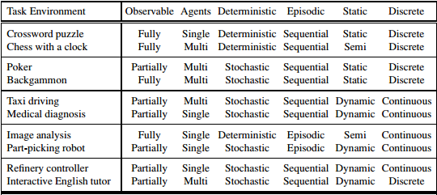

Slide 35
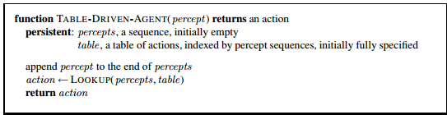
Agent Programme: Takes the current percept as input from the sensors and return an action to the actuators.
The TABLE-DRIVEN-AGENT program is invoked for each new percept and returns an action each time. It retains the complete percept sequence in memory
Notes:
Notes about this is in word file

Slide 36
Agent
Four basic types in order of increasing generality:
Simple reflex agents
Model-based reflex agents
Goal-based agents
Utility-based agents
Learning Agent (on your own)

Slide 37

Agents: Simple Reflex Agent
These agents select actions on the basis of the current percept, ignoring the rest of the percept history
Ex: Vacuum Cleaner : its decision is based only on the current location and on whether that location contains dirt
Notes:
Figure in Figure folder

Slide 38
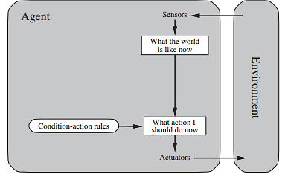
Agent: Simple Reflex Agent
condition–action-rule
if car-in-front-is-braking then initiate-braking
Limited intelligence

Slide 39
Agent: Model Based Agent
The most effective way to handle partial observability is for the agent to keep track of the part of the world it can’t see now. By maintaining Internal State
how the world works:???

Slide 40
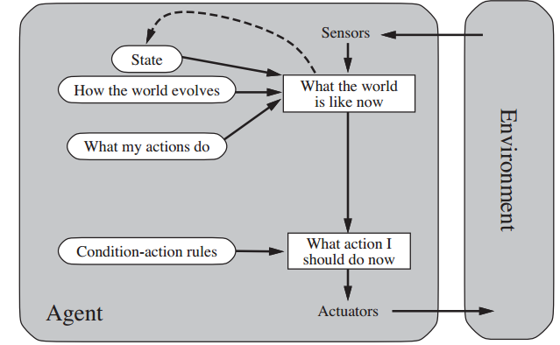
Agents: Model Based Agent

Slide 41
Agent: Goal Based Agent
Knowing something about the current state of the environment is not always enough to decide what to do. For example, at a road junction, the taxi can turn left, turn right, or go straight on.
The agent needs some sort of goal information that describes situations that are desirable

Slide 42
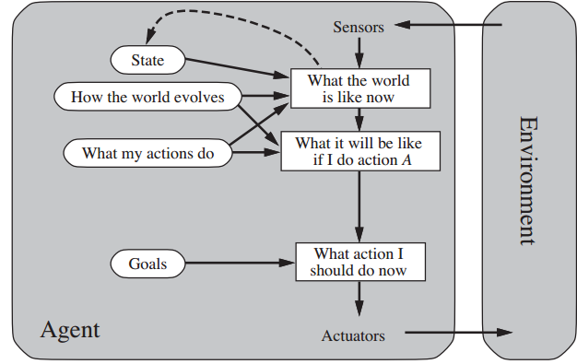
Agents: Goal Based Agent
It keeps track of the world state as well as a set of goals it is trying to achieve, and chooses an action that will (eventually) lead to the achievement of its goals.
Searching and Planning is mandatory
“What will happen if I do such-and-such?” and “Will that make me happy?

Slide 43
Agents: Utility Based Agent
Goals alone are not enough to generate high-quality behavior in most environments. For example, many action sequences will get the taxi to its destination (thereby achieving the goal) but some are quicker, safer, more reliable, or cheaper than others.
Goal Achieved or not????
Happy or Unhappy

Slide 44
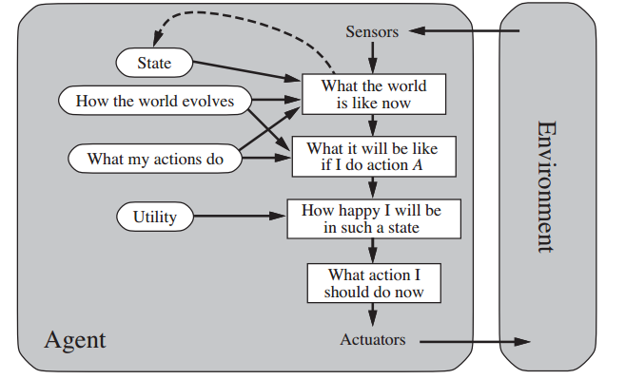
Agent: Utility Based Agents
It uses a model of the world, along with a utility function that measures its preferences among states of the world. Then it chooses the action that leads to the best expected utility, where expected utility is computed by averaging over all possible outcome states, weighted by the probability of the outcome

Slide 45
Agents: Learning Agents
On your own…

Slide 46
References
Russell, S. and Norvig, P., 2011, Artificial Intelligence: A Modern Approach, Pearson, India.
Rich, E. and Knight, K., 2004, Artificial Intelligence, Tata McGraw hill, India.

Slide 47
Thank You
Any Queries?
One Day Machine will be Intelligent. What about Man?

